Slide 1
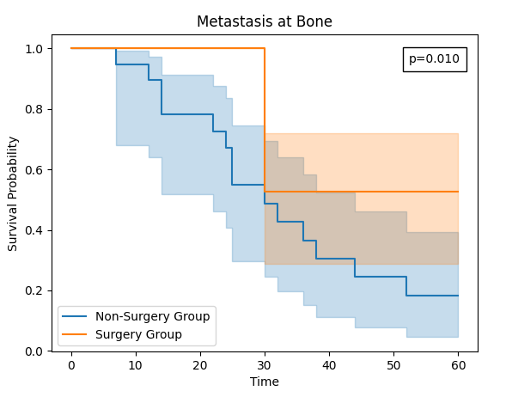
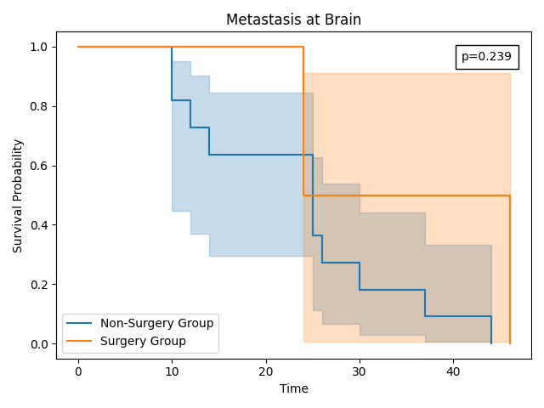
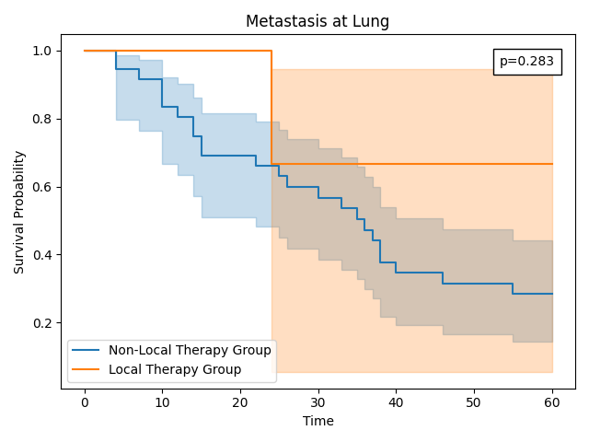
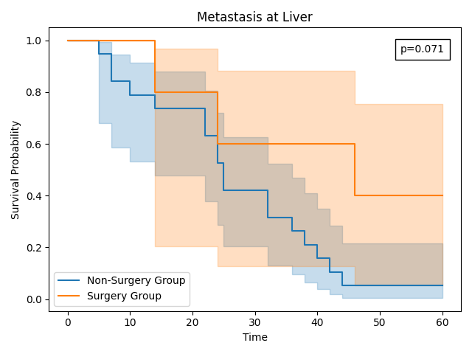
A
B
C
D

Slide 2
SEER dataset BC 2013–2018 (n=101,964)
Exclude due to missing variables (n=91,750)
Patients included in the analysis (n=10,214)
Training set (n=8,172)
Validation set (n=2,042)
Deep survival network
cox proportional hazards model
Model
Model evaluation concordance index, calibration curve
Optimal
Model
Shapley Additive Explanation
Model interpretability

